Slide 1
IP addresses, domain names, and URL
Learning how the web works

Slide 2
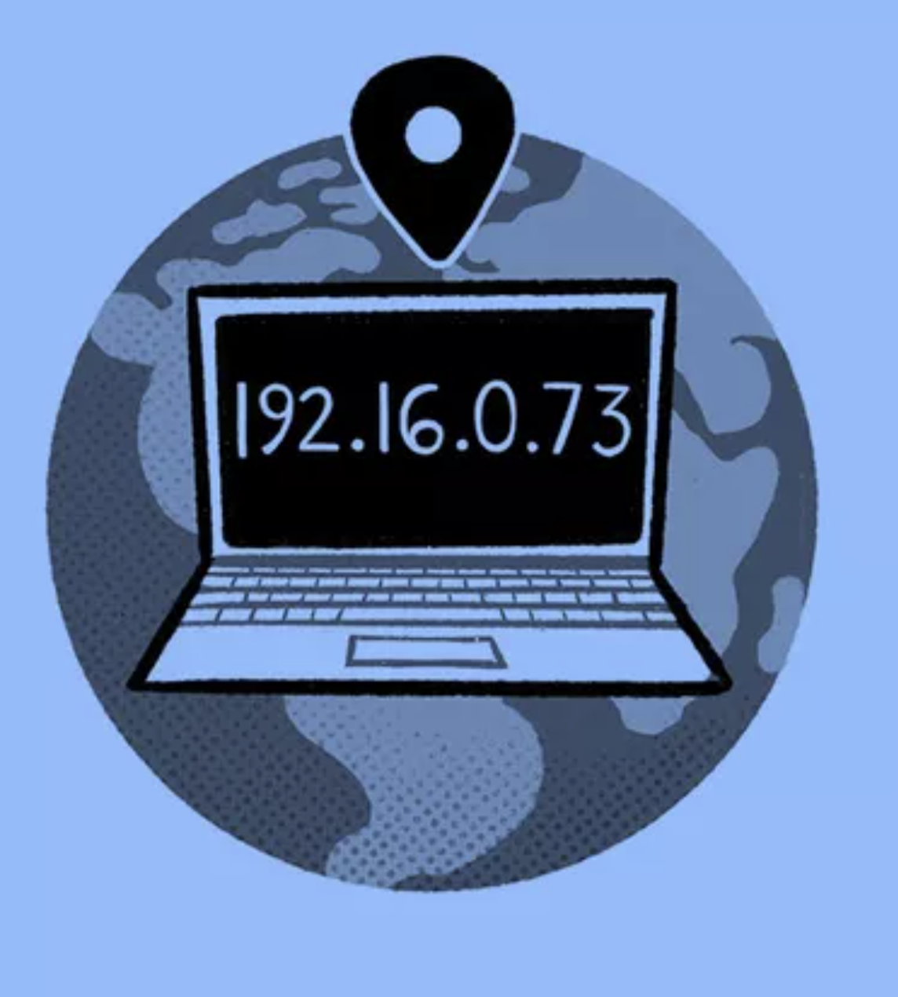
IP Addresses
Internet Communication: Computers communicate on the internet by exchanging packets.
Packet Contents:
To and From IP Addresses: Specify the sender and receiver’s addresses.
Information: Contains the data being communicated.
Configuration Information: Includes additional settings for the communication.
IP Address:
Stands for Internet Protocol address.
Acts as a computer’s unique address on the internet, similar to a house address.

Slide 3
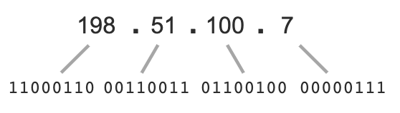
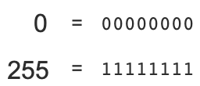
An IP address is usually written as four numbers separated by dots
Each number represents 8 bits of the IP address, for a total of 32 bits
The smallest possible number in an IP address is 0, and the largest is 255.

Slide 4
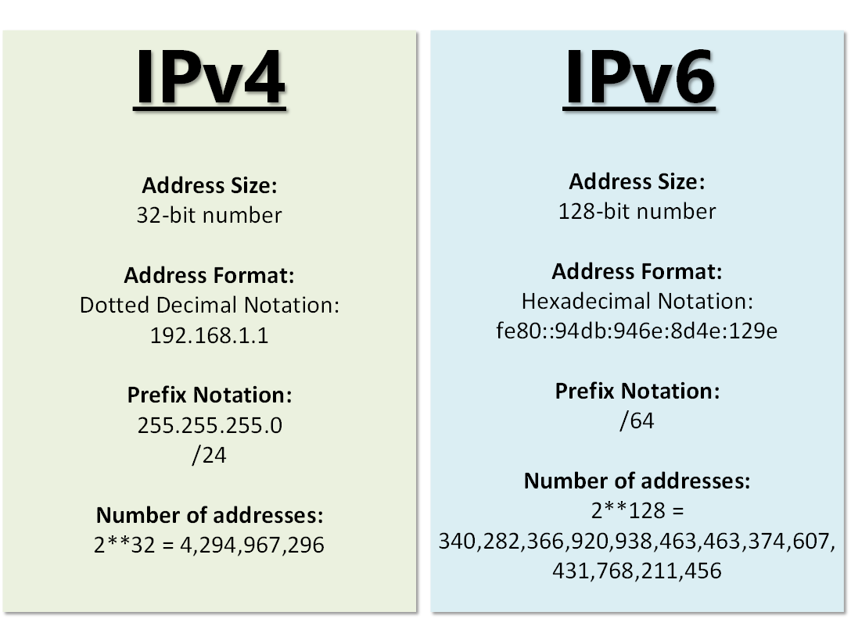
IPv4
The original Internet Protocol version.
Uses 32-bit addresses, capable of representing 2³² (about 4 billion) unique addresses.
Initially believed to be sufficient but is no longer enough.
IPv6
The newer version of the Internet Protocol.
Uses 128-bit addresses, capable of representing 2¹²⁸ addresses.
2¹²⁸ is approximately 3.4 x 10³⁸ or 340 undecillion addresses, expected to suffice for the foreseeable future.
Coexistence
IP Address:
IPv4 and IPv6 currently operate simultaneously.
Both protocols are expected to coexist for an extended period.

Slide 5
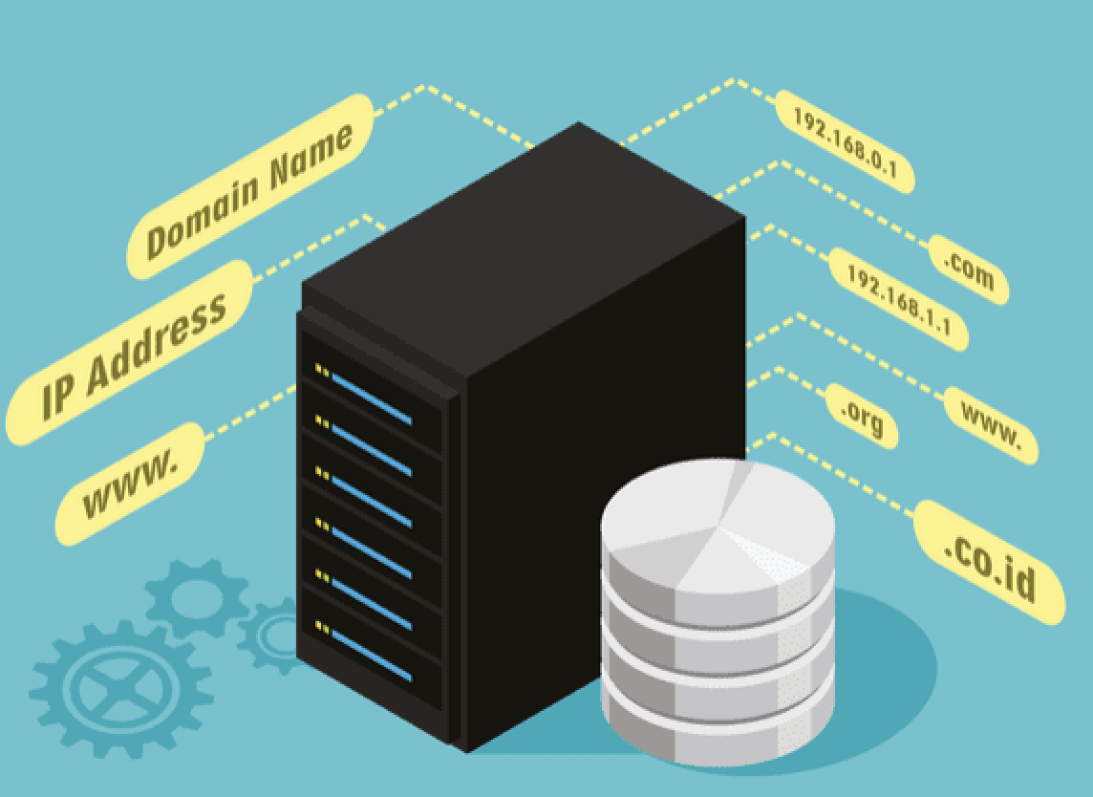
Domain names and DNS
Some websites can be directly reached using the computer system's IP address.
Ex: Google could say "Go to 216.58.193.206 to search the internet."
Issues
Addresses are hard to remember
IP addresses can change

Slide 6
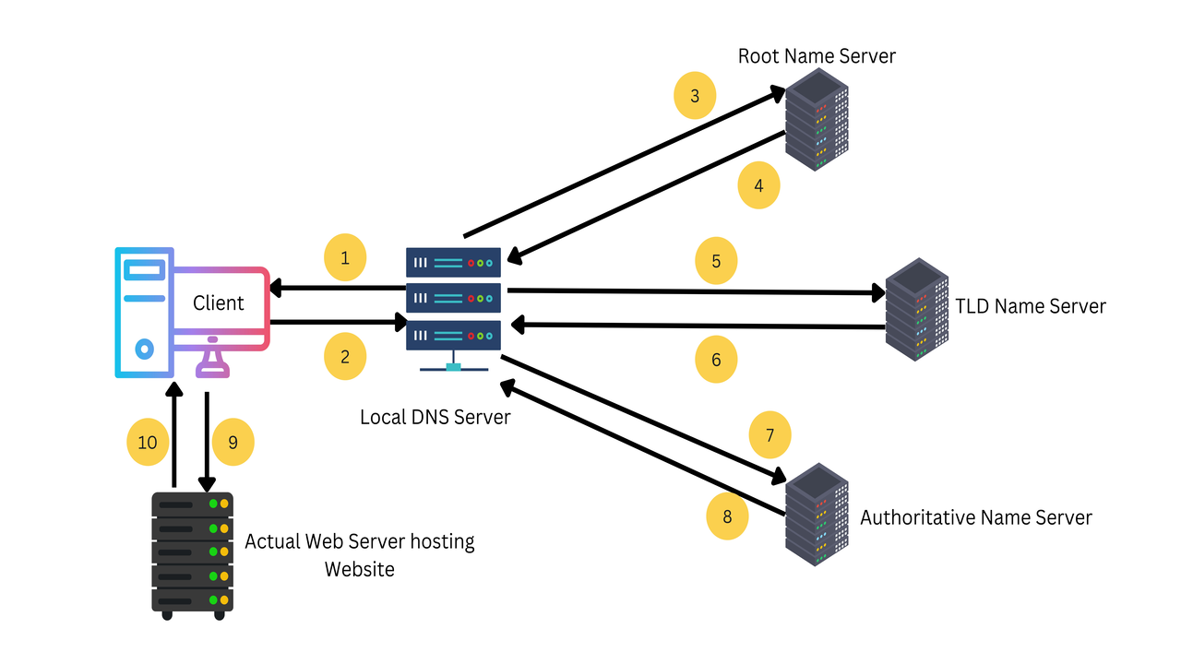
Domain Name
A human-readable name for an IP address (e.g., wikipedia.org for 198.35.26.96).
Easier to remember and type than IP addresses.
Case-insensitive: Wikipedia.org, wikipedia.org, and WIKIPEDIA.ORG are treated the same.
Domain Name Resolution
When sending a packet using a domain name, the computer first contacts a DNS server to convert the domain name into an IP address.
DNS: Stands for Domain Name System.
Root DNS Servers
Thirteen main DNS servers exist globally, known as root servers.
A computer’s operating system or Internet Service Provider (ISP) maintains references to their IP addresses.

Slide 7
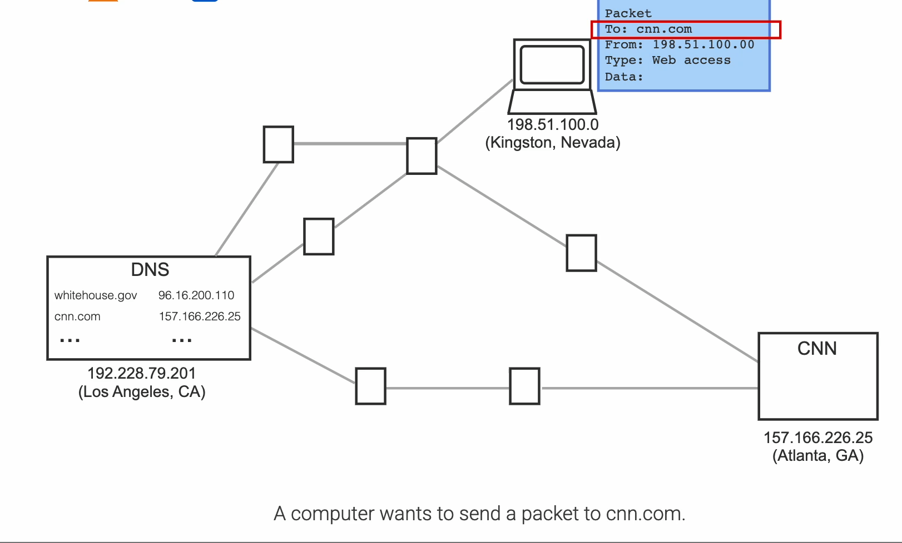

Slide 8
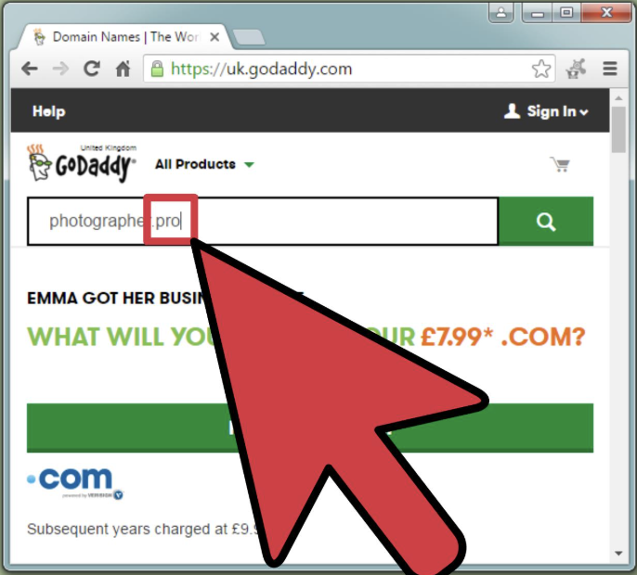
Domain Name Registration:
Anyone can register an unused domain name through a domain name registrar.
Registrars typically charge a yearly fee to maintain the registration.
Registration details are publicly available via ICANN’s Whois service.
Website Hosting
When hosting a website with a web hosting company, the hosting provider updates the DNS servers to link the domain name to the website’s IP address.
Hosting companies may also handle the annual renewal of the domain name registration.

Slide 9
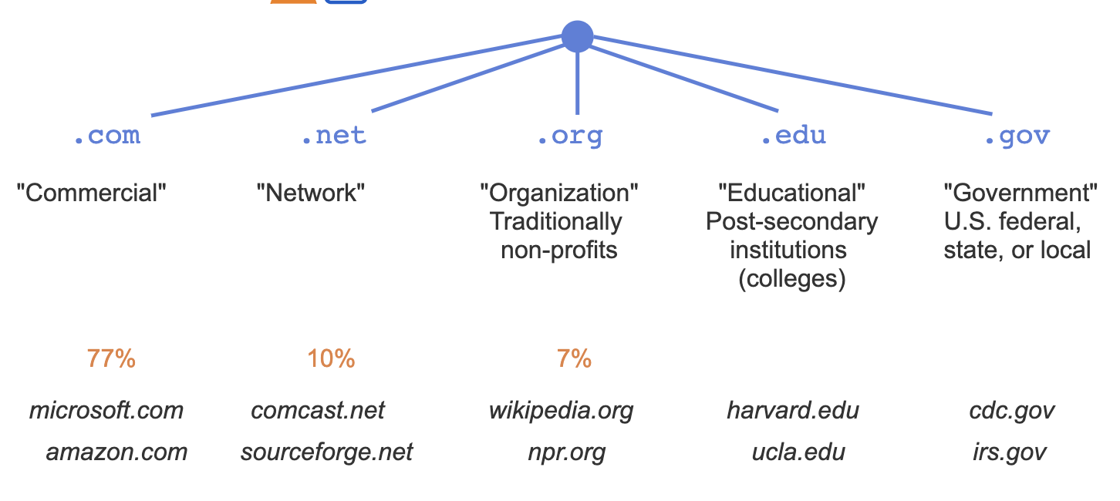
Domain name levels

Slide 10
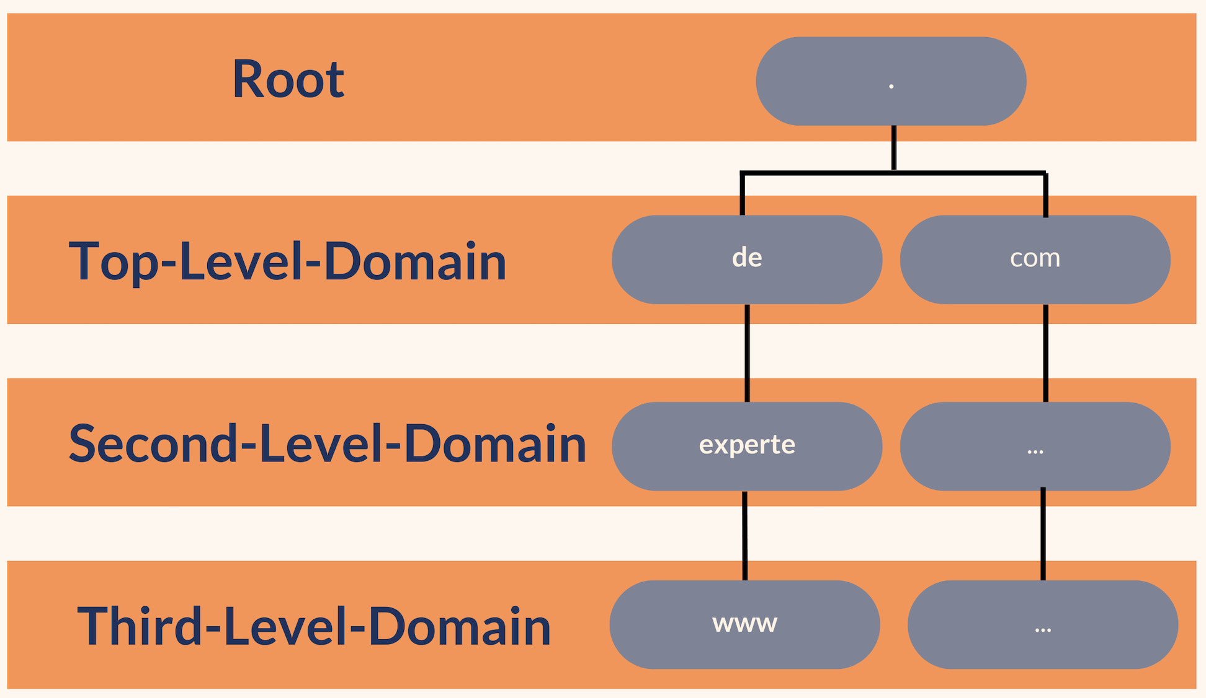
Domain name levels
Domain Name Hierarchy:
Domain names are organized into a hierarchical structure.
Each domain name belongs to a top-level domain (TLD).
Types of TLDs:
Generic TLDs (gTLDs): Common TLDs like .com, .net, .org, .edu, and .gov.
Country Code TLDs (ccTLDs): Unique two-letter codes assigned to countries, such as:
.sa: Saudi Arabia
.ru: Russia.
Customized TLDs:
Managed by IANA (Internet Assigned Numbers Authority).

Slide 11
Domain name levels
Second-Level Domain (SLD)
Follows the top-level domain (TLD)
Typically represents an organization’s name or the website’s purpose.
Example: wikipedia in wikipedia.org.
Example: Stanford in Stanford.edu.
Third-Level Domain and Beyond
Refers to sub-computer systems within an organization.
Example: cs.stanford.edu, where cs indicates Stanford’s Computer Science department.

Slide 12
Domain name levels
Internet domain names are divided by top-level domains.
The most popular is .com. Most companies have a .com name.
Next most popular is .net. Typically for networking/internet-focused companies.
Next is .org, traditionally for non-profit organizations.
Other well-known top-level domains are .edu for colleges, and .gov for U.S. governments. Hundreds more exist.

Slide 13

URLs
Domain Names in URLs
URL Composition

Slide 14
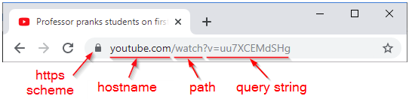
Domain Names in URLs
Domain names are commonly used in URLs (Uniform Resource Locators).
A URL specifies the location of a web resource (e.g., HTML file, image, video, CSS file).

Slide 15
URL Composition
Scheme: Appears at the start of a URL, followed by a colon “:” or “://”
Example: In https://www.cdc.gov/alcohol, the scheme is “https”
Hostname: The complete domain name following the scheme.
Example: In https://www.cdc.gov/alcohol, the hostname is “www.cdc.gov”.
Path: Characters following the hostname that specify the resource’s location.
Example: In https://www.cdc.gov/alcohol, the path is ”/alcohol”.
Query String (Optional):
Characters after the ? that provide data for the web server.
Example: In https://www.youtube.com/watch?v=uu7XCEMdSHg, the query string is “v=uu7XCEMdSHg”

Slide 16
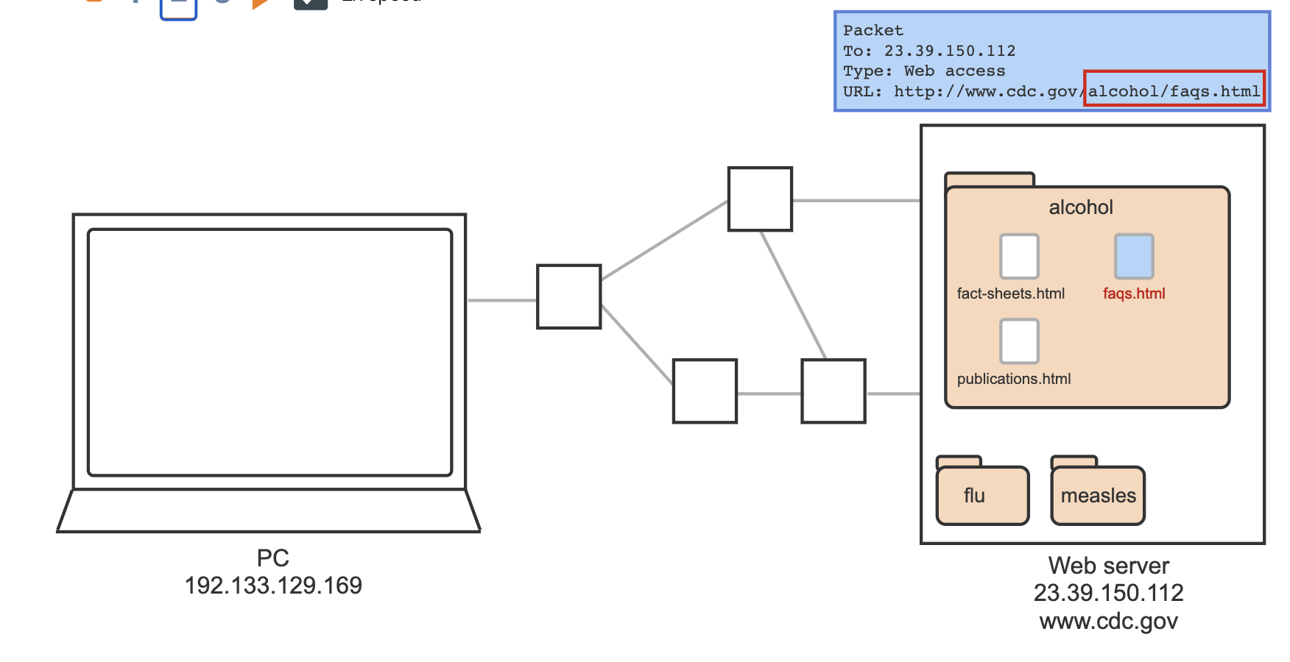
URL Composition
Fragment (Optional): Characters after the # that refer to a specific section within a webpage.
Example: In https://en.wikipedia.org/wiki/URL#History, the fragment is ”#History”
A URL can specify the location of subfolders and files.

Slide 17
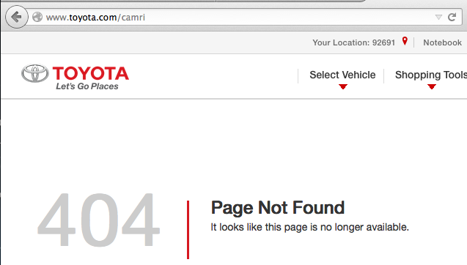
Webpage Errors
Domain Name Not Found
Occurs when a DNS server cannot find the domain name, often because it is not registered.
Results in a message like:
“Sorry, the website www.xyz.blahblahblah cannot be found.”
Domain Name Found but No Response
A valid IP address exists, but the web server does not respond.
Common messages include:
“The website is not responding”
“Could not reach the website”
Possible reasons:
The web server is offline or under maintenance.
A critical router is malfunctioning.

Slide 18
Webpage Errors
404 Status Code
If the web server is reached but the specific page is not found, it returns a 404 status code.
The code 404 indicates page not found.
Many servers display a custom page with the number 404 included.
Other Status Codes
Web servers use various other status codes to communicate different responses or errors.

Slide 19
Webpage Errors
Linkrot
Refers to a previously valid link that now returns a 404 status code because the associated content has been removed from the web.
Fighting Linkrot
Organizations like the Internet Archive combat linkrot by archiving web content for future reference.
Wayback Machine
A tool provided by the Internet Archive.
Offers access to billions of archived webpages.
Allows users to view how a URL appeared at different points in history.

Slide 20
Key Takeaways
Internet Communication
Computers communicate using packets containing IP addresses and other data.
IP addresses uniquely identify devices on the internet.
Domain Names
Simplify access to websites by serving as easy-to-remember names for IP addresses.
Domain names are hierarchical (e.g., TLDs, SLDs, third-level domains).
URL Structure
A URL includes parts like scheme, hostname, path, query string, and fragment.
Error Codes and Linkrot:
404 Status Code: Indicates a page is not found.
Linkrot: Occurs when a valid link no longer points to content.
Tools like the Wayback Machine preserve web history.
DNS and Hosting
DNS servers translate domain names into IP addresses.
Hosting providers link domain names to web servers.
Web Evolution
The internet is dynamic, with content frequently added and removed.
Organizations like the Internet Archive help mitigate linkrot.

